Slide 1
Financial Accounting
IFRS 4th Edition
Weygandt ● Kimmel ● Kieso
Chapter 3
Adjusting the Accounts

Slide 2
Chapter Preview
In Chapter 1, you learned a neat little formula: Net income = Revenues – Expenses.
In Chapter 2, you learned some rules for recording revenue and expense transactions.
Guess what?
Things are not really that nice and neat. In fact, it is often difficult for companies to determine in what time period they should report some revenues and expenses. In other words, in measuring net income, timing is everything.

Slide 3
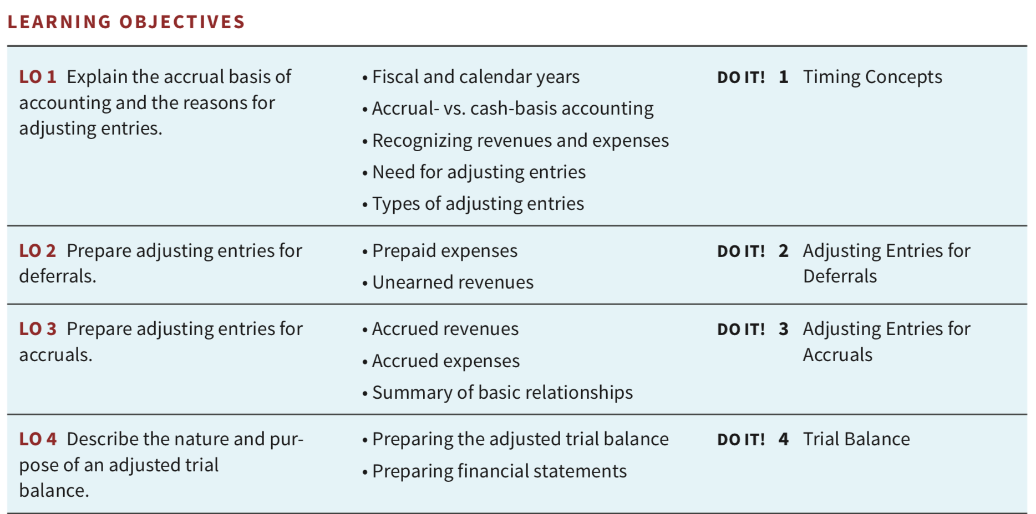
Chapter Outline
The learning objectives for Appendix A and B follow below the chapter slides.

Slide 4
Learning Objective 1 Explain the accrual basis of accounting and the reasons for adjusting entries.
LO 1

Slide 5
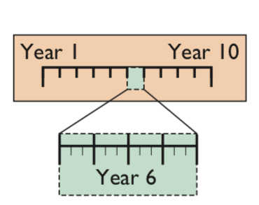
Accrual-Basis Accounting and Adjusting Entries
Time period (or periodicity) assumption: Accountants divide the economic life of a business into artificial time periods.
LO 1

Slide 6
Fiscal and Calendar Years
Accounting time periods are generally a month, a quarter, or a year.
Monthly and quarterly time periods are called interim periods.
Most large companies must prepare both quarterly and annual financial statements.
Fiscal Year = Accounting time period that is one year in length.
Calendar Year = January 1 to December 31.
Sometimes a company’s year-end will vary from year to year, resulting in accounting periods of either 52 or 53 weeks.
LO 1

Slide 7
Accrual- versus Cash-Basis Accounting
Accrual-Basis 발생주의 Accounting
Transactions are recorded in the periods in which the events occur.
Companies recognize revenues when they perform services (rather than when they receive cash).
Expenses are recognized when incurred (rather than when paid).
Accrual-basis accounting is in accordance with IFRS.
LO 1

Slide 8
Accrual- versus Cash-Basis Accounting
Cash-Basis 현금주의 Accounting
Revenues are recorded when cash is received.
Expenses are recorded when cash is paid.
Cash-basis accounting is not in accordance with IFRS.
LO 1

Slide 9
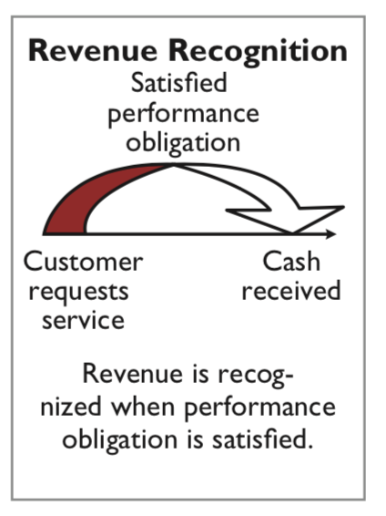
Recognizing Revenues and Expenses
LO 1

Slide 10
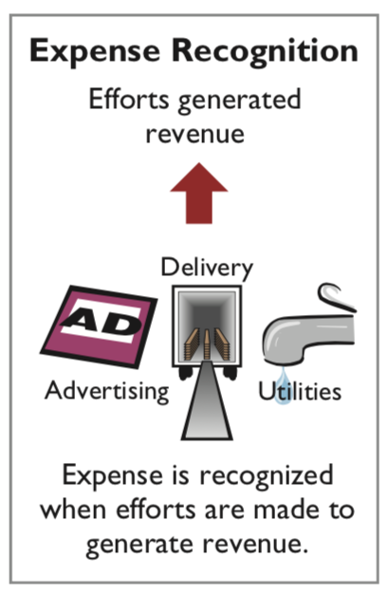
Recognizing Revenues and Expenses
LO 1

Slide 11
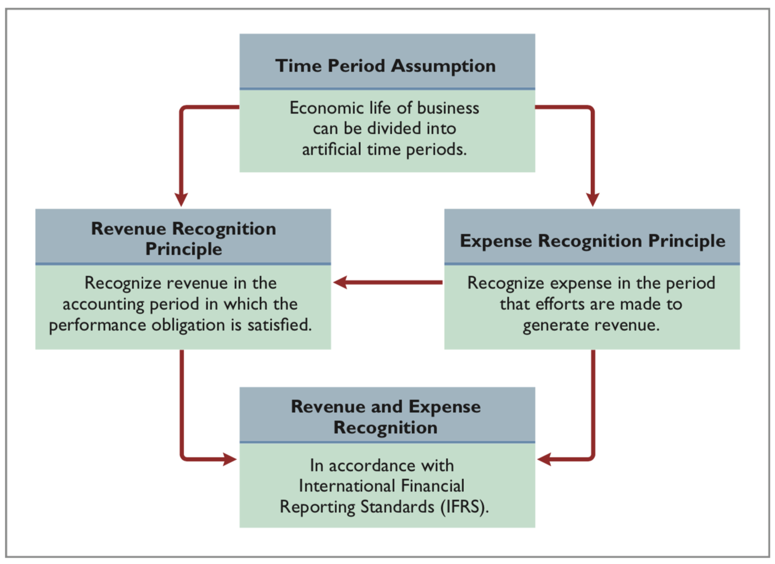
Recognizing Revenues and Expenses
LO 1

Slide 12

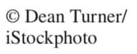
Cooking the Books? What motivates sales executives and finance and accounting executives to participate in activities that result in inaccurate reporting of revenues?
Ethics Insight Krispy Kreme
Answer and additional questions: See the book’s companion website.
LO 1

Slide 13
The Need for Adjusting Entries
Adjusting entries 수정분개 ensure that the revenue recognition and expense recognition principles are followed.
Required every time a company prepares financial statements.
Will include one income statement account and one statement of financial position account.
LO 1

Slide 14
The Need for Adjusting Entries
Reasons:
Some events are not recorded daily because it is not efficient to do so.
Some costs are not recorded during the accounting period because these costs expire with the passage of time rather than as a result of recurring daily transactions.
Some items may be unrecorded.
LO 1

Slide 15
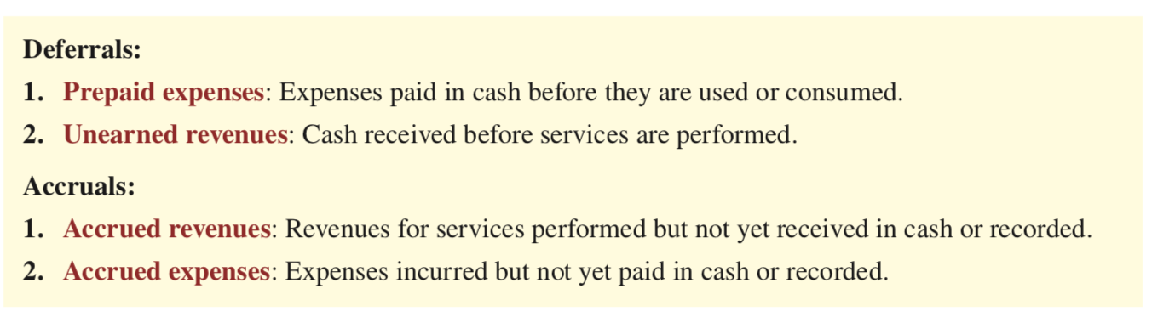

Types of Adjusting Entries
LO 1

Slide 16
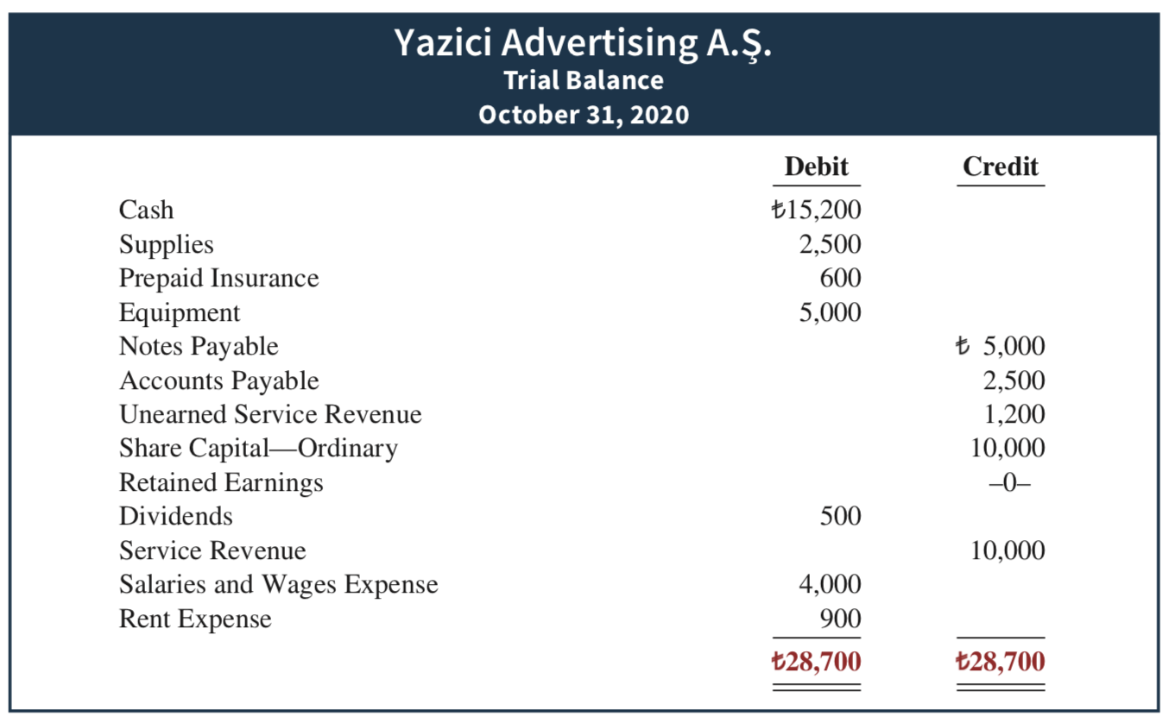

Analyze each account to determine whether it is complete and up-to-date for financial statement purposes.
LO 1

Slide 17
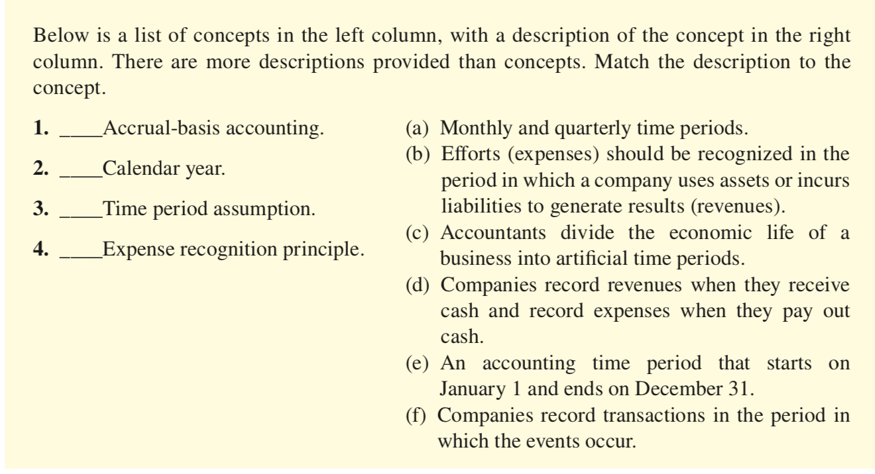
DO IT! Timing Concepts
Continues on next slide
LO 1

Slide 18
DO IT! Timing Concepts
ACTION PLAN
Review the definitions of the timing concepts in the Glossary Review section.
Study carefully the revenue recognition principle, the expense recognition principle, and the time period assumption.
LO 1

Slide 19
DO IT! Timing Concepts
Solution
1.f
2.e
3.c
4.b
Related exercise material:
BE3.1, DO IT! 3.1, E3.1, E3.2, and E3.3.
LO 1

Slide 20
Learning Objective 2 Prepare adjusting entries for deferrals.
LO 2

Slide 21
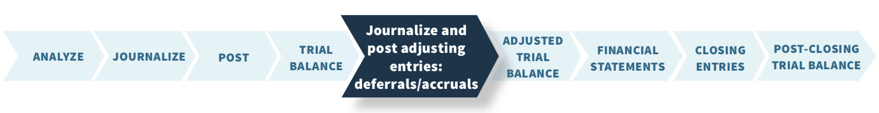
Adjusting Entries for Deferrals
Deferrals are expenses or revenues that are recognized at a date later than the point when cash was originally exchanged.
There are two types:
Prepaid expenses, and
Unearned revenues.
LO 2

Slide 22
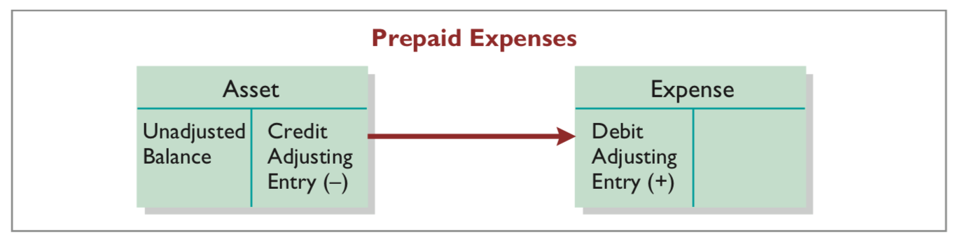
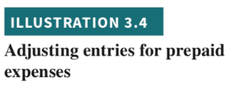
Prepaid Expenses
Prepaid expenses are costs that expire either with the passage of time (e.g., rent and insurance) or through use (e.g., supplies).
Prior to adjustment, assets are overstated and expenses are understated.
LO 2

Slide 23
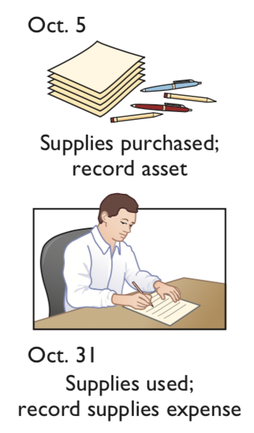
Supplies
Rather than record supplies expense as the supplies are used, companies recognize supplies expense at the end of the accounting period.
LO 2

Slide 24
Supplies
Assume: Yazici Advertising purchased supplies costing 2,500 on October 5. Yazici recorded the purchase by increasing (debiting) the asset Supplies. This account shows a balance of 2,500 in the October 31 trial balance. An inventory count at the close of business on October 31 reveals that 1,000 of supplies are still on hand.
Demonstrate: How do you record the adjustment for supplies?
Continues on next slide
LO 2

Slide 25
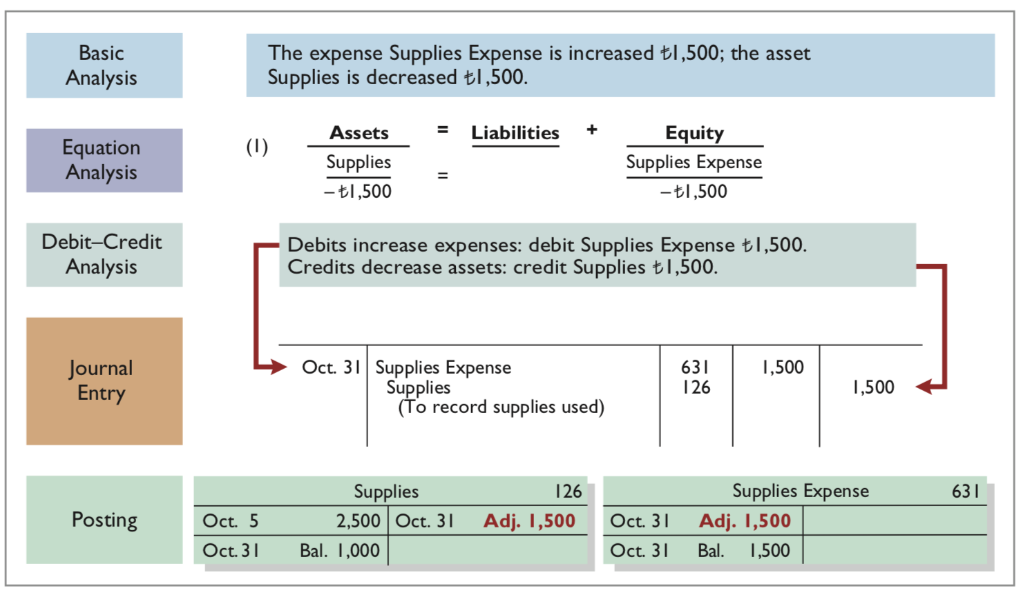

Supplies
LO 2

Slide 26
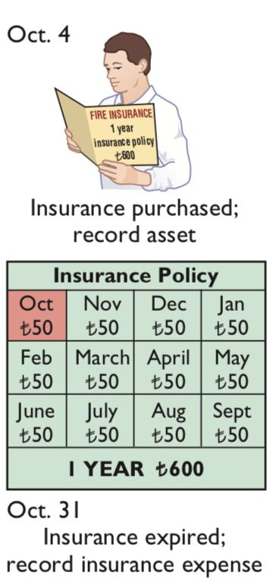
Insurance
LO 2

Slide 27
Insurance
Assume: On October 4, Yazici Advertising paid 600 for a one-year fire insurance policy. Coverage began on October 1. Yazici recorded the payment by increasing (debiting) Prepaid Insurance.
Demonstrate: How do you record the adjustment for insurance?
Continues on next slide
LO 2

Slide 28
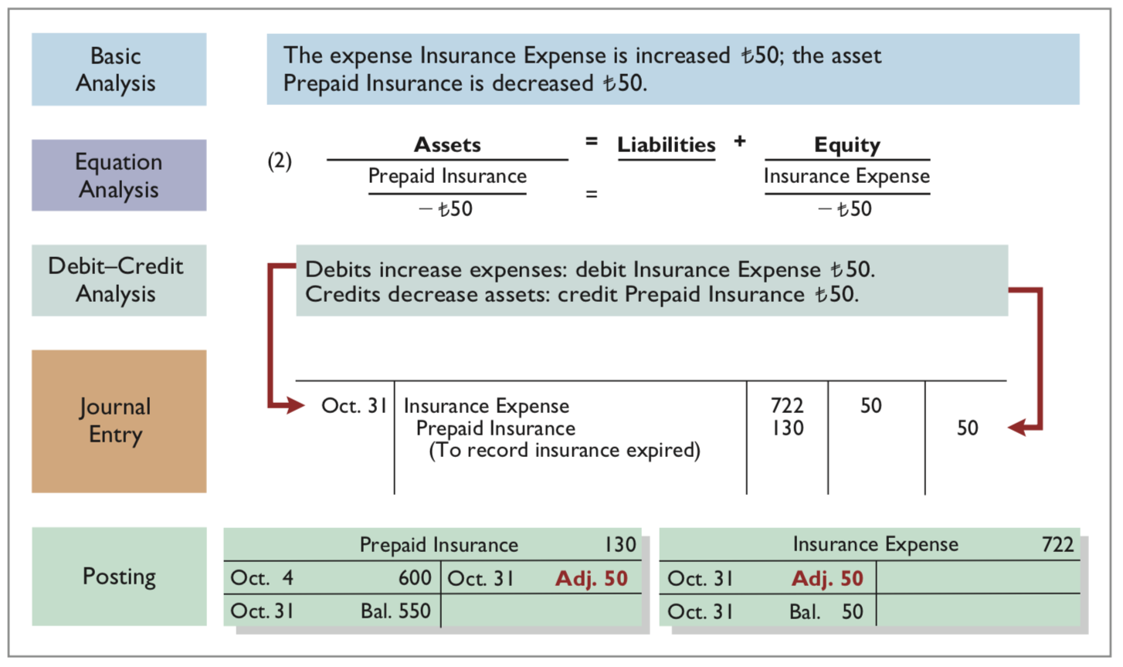

Insurance
LO 2

Slide 29
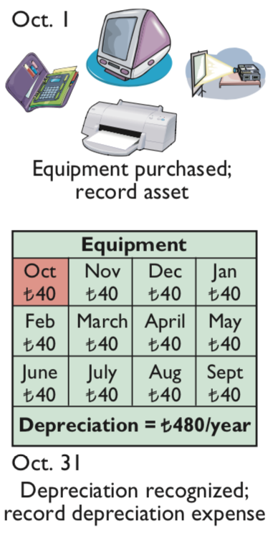
Depreciation
Depreciation is the process of allocating the cost of an asset to expense over its useful life.
Depreciation is an allocation concept, not a valuation concept.
That is, depreciation allocates an asset’s cost to the periods in which it is used.
Depreciation does not attempt to report the actual change in the value of the asset.
LO 2

Slide 30
Depreciation
Assume: For Yazici Advertising, depreciation on the equipment is 480 a year, or 40 per month.
Demonstrate: How do you record the adjustment for depreciation?
Continues on next slide
LO 2

Slide 31
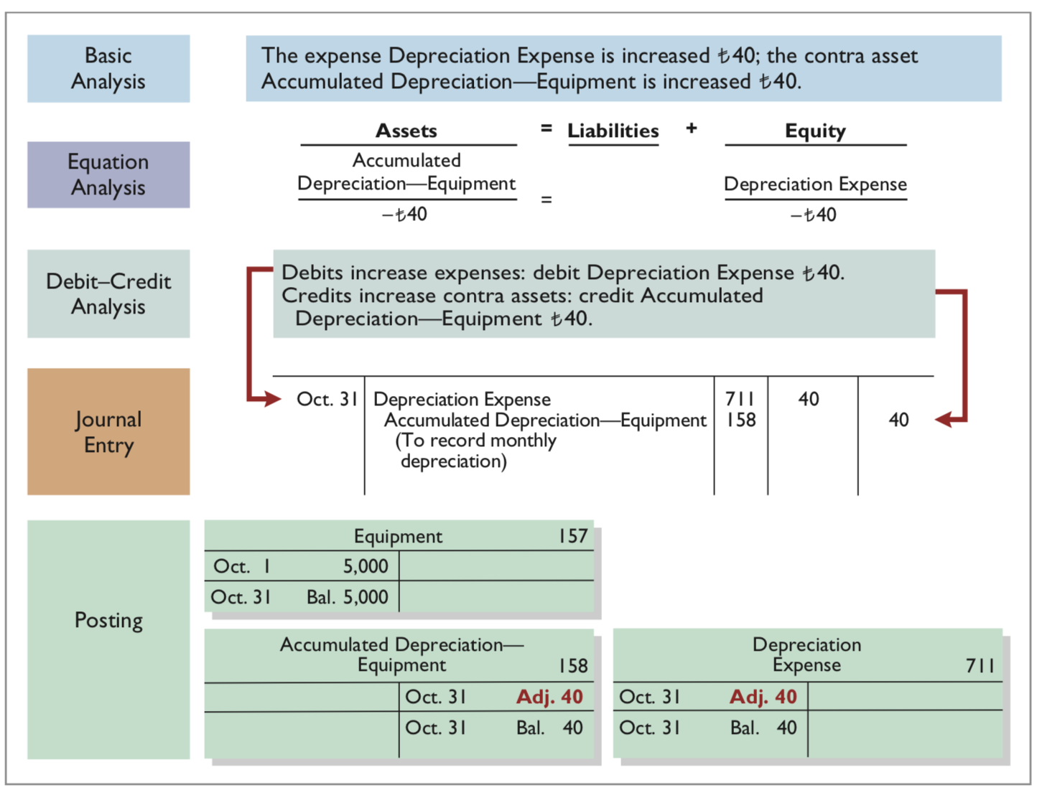
Depreciation
HELPFUL HINT
All contra accounts have increases, decreases, and normal balances opposite to the account to which they relate.
LO 2

Slide 32

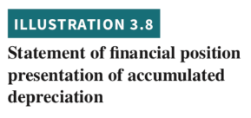
Prepaid Expenses
Statement Presentation.
1
1
Book value or carrying value: Difference between the cost of any depreciable asset and its related accumulated depreciation
LO 2

Slide 33
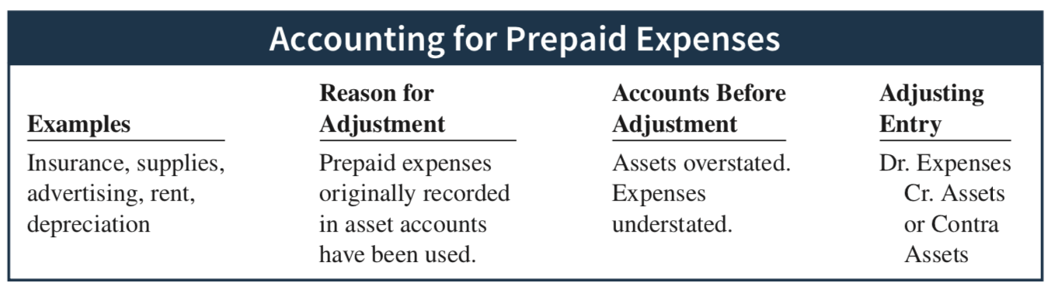
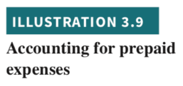
Prepaid Expenses Summary
LO 2

Slide 34

Unearned Revenues
LO 2

Slide 35
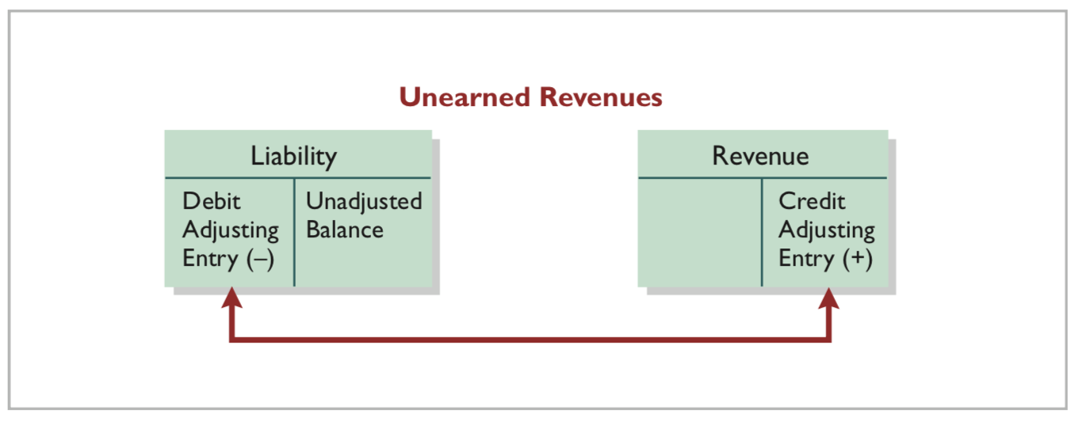
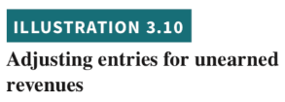
Unearned Revenues
When companies receive cash before services are performed, they record a liability by increasing (crediting) a liability account called unearned revenues.
Prior to adjustment, liabilities are overstated and revenues are understated.
LO 2

Slide 36
Service Revenue
Assume: Yazici Advertising received 1,200 on October 2 from R. Knox for advertising services expected to be completed by December 31. Yazici credited the payment to Unearned Service Revenue. This liability account shows a balance of 1,200 in the October 31 trial balance.
Demonstrate: How do you record the adjustment for advertising revenue?
Continues on next slide
LO 2

Slide 37
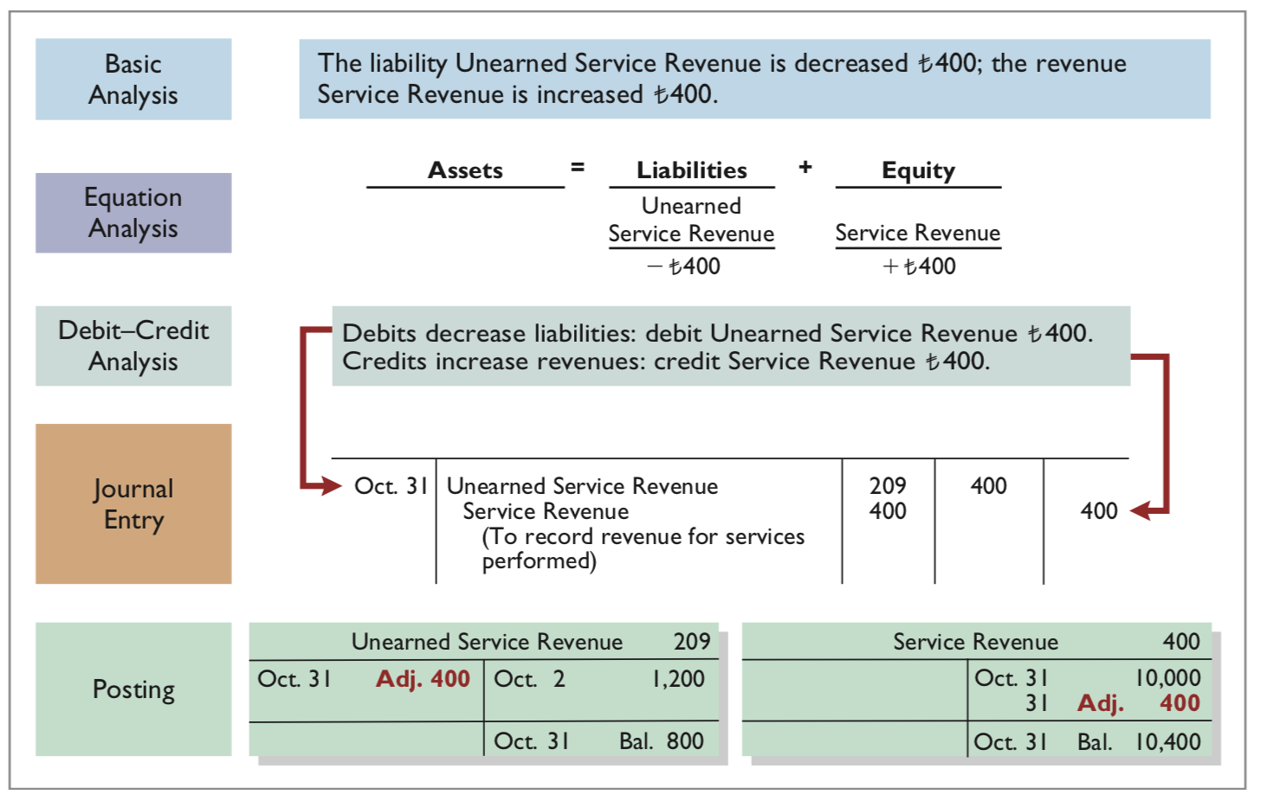
Service Revenue
LO 2

Slide 38
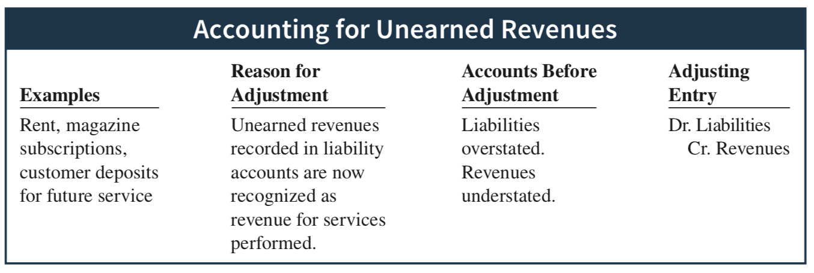
Unearned Revenues
LO 2

Slide 39


Turning Gift Cards into Revenue Suppose that Robert Jones purchases a €100 gift card on December 24, 2019, and gives it to his wife, Mary Jones, on December 25, 2019. On January 3, 2020, Mary uses the card to purchase €100 worth of CDs. When do you think the company should recognize revenue and why?
Accounting Across the Organization Marks & Spencer plc
Answer and additional questions: See the book’s companion website.
LO 2

Slide 40
Learning Objective 3 Prepare adjusting entries for accruals.
LO3

Slide 41

Adjusting Entries for Accruals
Accruals are made to record the following:
Revenues for services performed but not yet recorded at the statement date – accrued revenues or
Expenses incurred but not yet paid or recorded at the statement date – accrued expenses
LO 3

Slide 42
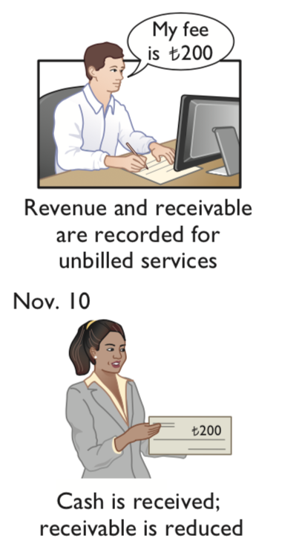
Accrued Revenues
LO 3

Slide 43
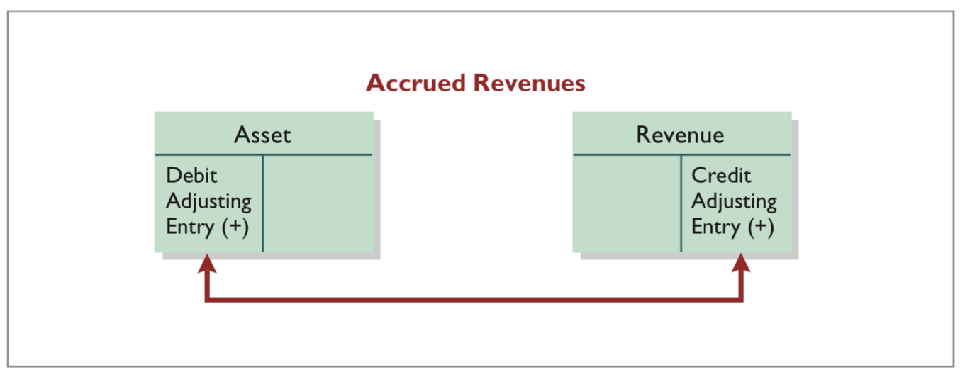
Accrued Revenues
Prior to adjustment, both assets and revenues are understated.
An adjusting entry for accrued revenues results in an increase (a debit) to an asset account and an increase (a credit) to a revenue account.
LO 3

Slide 44
Accrued Revenues
Assume: In October, Yazici Advertising performed services worth 200 that were not billed to clients on or before October 31. Because these services were not billed, they were not recorded.
Demonstrate: How do you adjust for accrued revenue?
Continues on next slide
LO 3

Slide 45
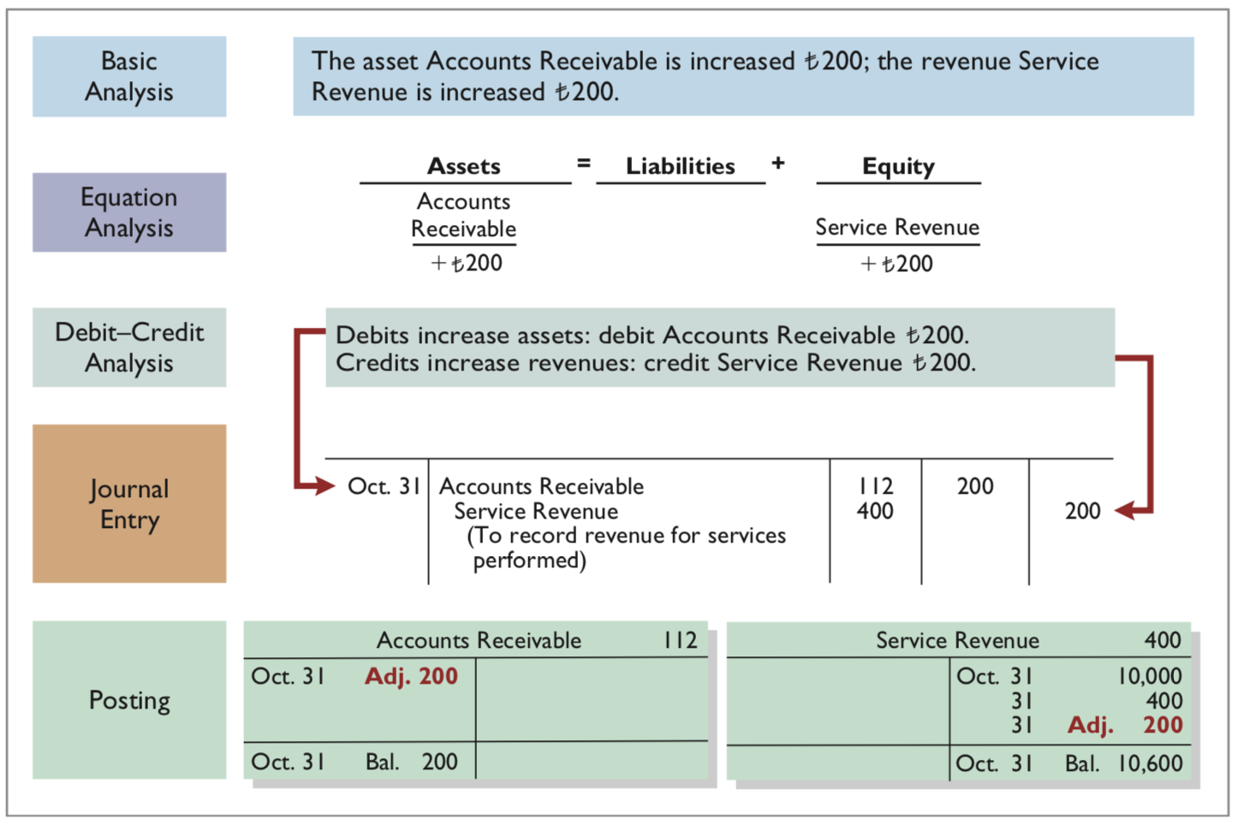
Accrued Revenues
LO 3

Slide 46
Accrued Revenues
Assume: On November 10, Yazici receives cash of 200 for the services performed in October and makes the following entry.
Demonstrate: How do you record the collection of the receivables?
Continues on next slide
LO 3

Slide 47
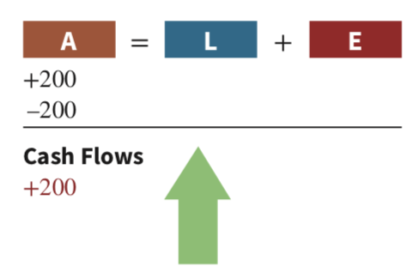

Accrued Revenues
LO 3

Slide 48
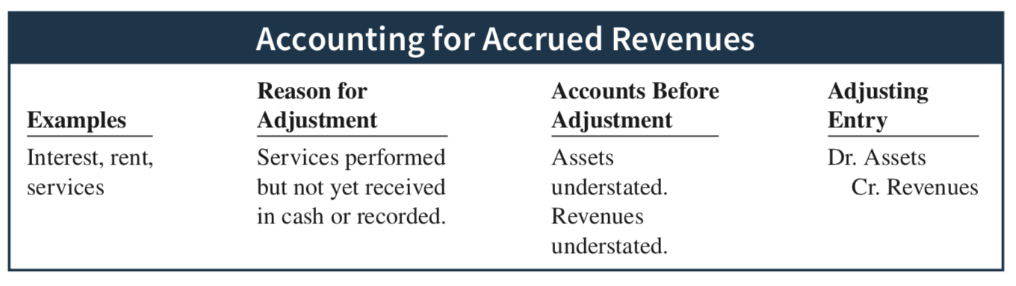
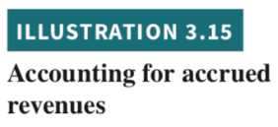
Accrued Revenues - Summary
LO 3

Slide 49
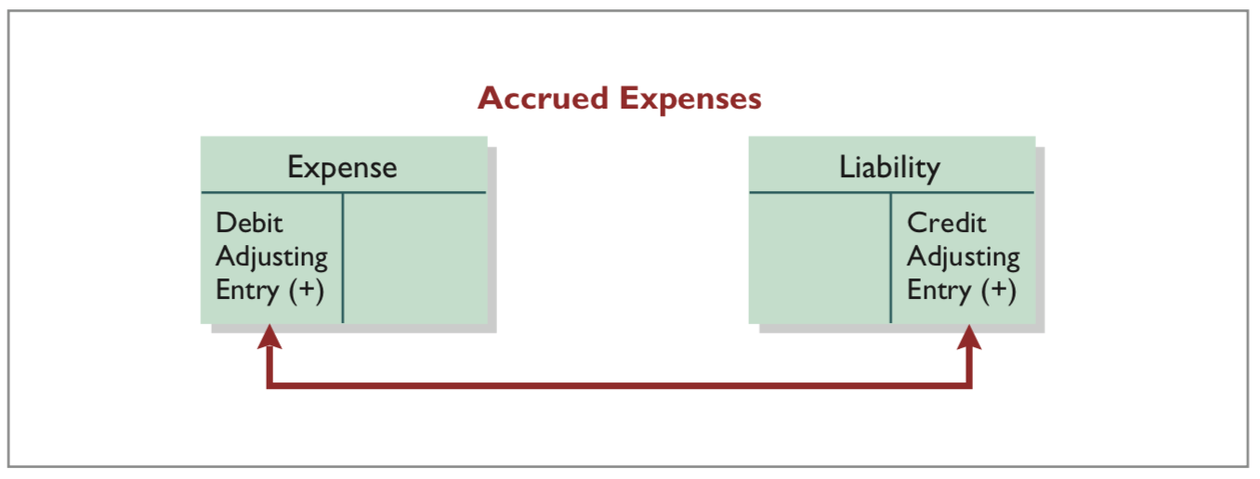
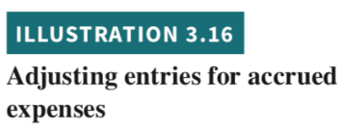
Accrued Expenses
Prior to adjustment, both liabilities and expenses are understated.
An adjusting entry for accrued expenses results in an increase (a debit) to an expense account and an increase (a credit) to a liability account.
LO 3

Slide 50
Accrued Interest
Assume: Yazici Advertising signed a three-month note payable in the amount of 5,000 on October 1. The note requires Yazici to pay interest at an annual rate of 12%.
Demonstrate:
How do you determine the interest to be recorded?
How do you create the adjustment for accrued interest?
Continues on next slide
LO 3

Slide 51
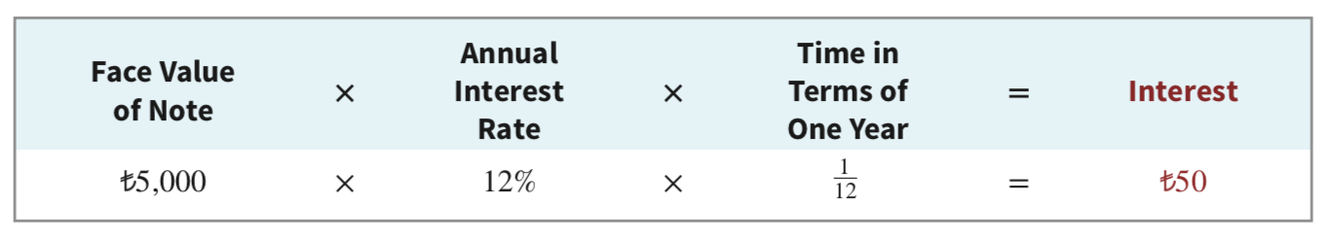

Accrued Interest
Continues on next slide
LO 3

Slide 52
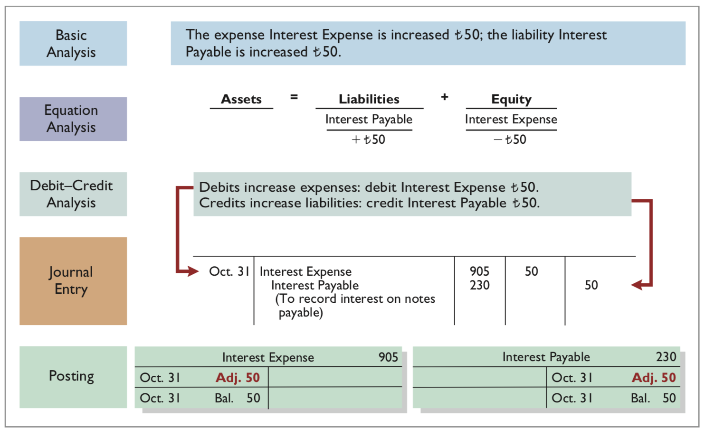

Accrued Interest
LO 3

Slide 53
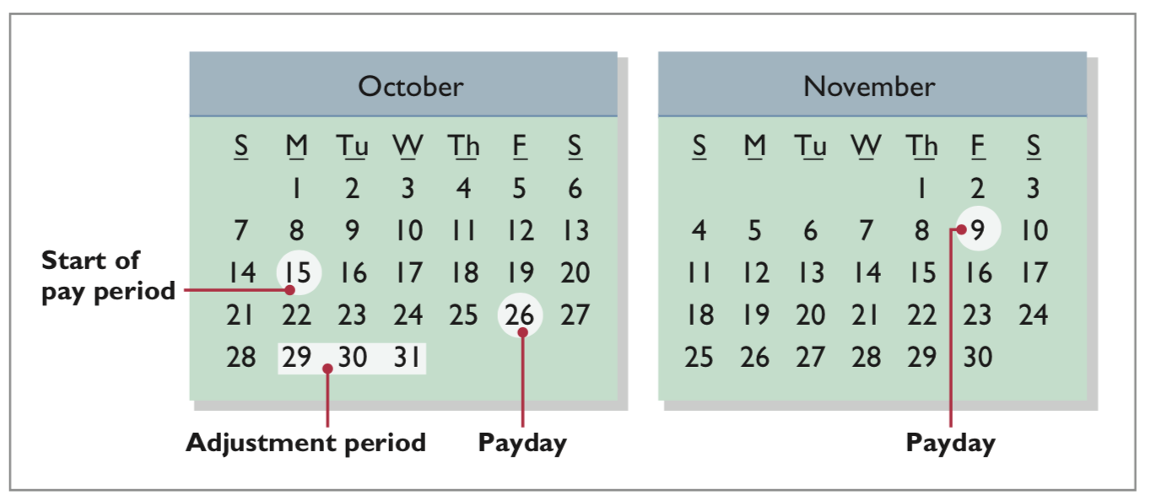

Accrued Salaries and Wages
LO 3

Slide 54
Accrued Salaries and Wages
Assume: At October 31, the salaries and wages for these three days represent an accrued expense and a related liability to Yazici. The employees receive total salaries and wages of 2,000 for a five-day work week, or 400 per day. Thus, accrued salaries and wages at October 31 are 1,200 ( 400 × 3).
Demonstrate: How do you create the adjustment for accrued salaries and wages?
Continues on next slide
LO 3

Slide 55
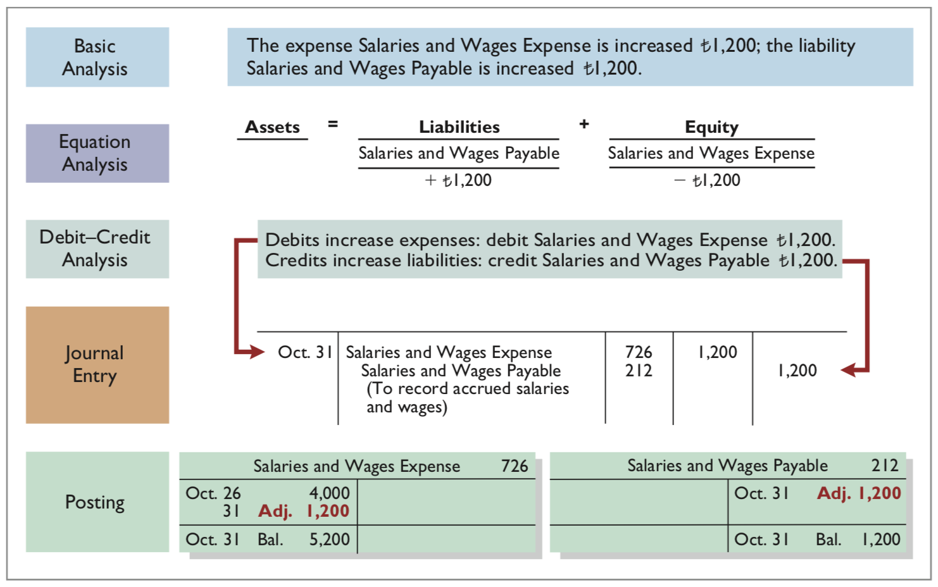
Accrued Salaries and Wages
LO 3

Slide 56
Accrued Salaries and Wages
Assume: Yazici pays salaries and wages every two weeks. Consequently, the next payday is November 9, when the company will again pay total salaries and wages of 4,000. The payment consists of 1,200 of salaries and wages payable at October 31 plus 2,800 of salaries and wages expense for November (7 working days, as shown in the November calendar × 400).
Demonstrate: Which entry does Yazici make on November 9?
Continues on next slide
LO 3

Slide 57
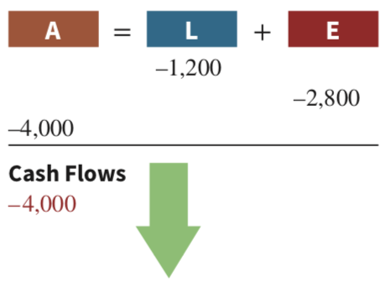

Accrued Salaries and Wages
LO 3

Slide 58
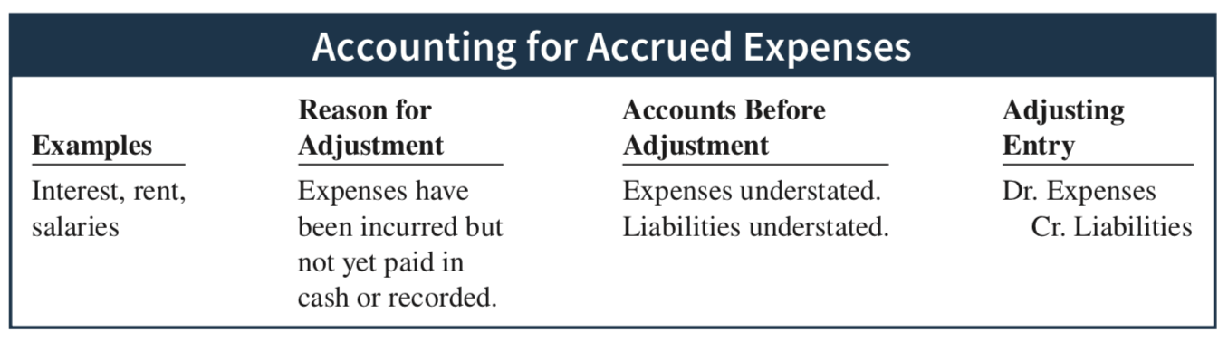
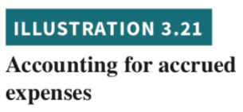
Accrued Expenses - Summary
LO 3

Slide 59

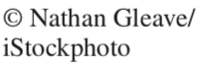
People, Planet, and Profit Insight Got Junk? What accounting issue might this cause for companies?
Answer and additional questions: See the book’s companion website.
LO 3

Slide 60
Adjusting Entries
Adjusting entries should not involve debits or credits to Cash.
Evaluate whether the adjustment makes sense. For example, an adjustment to recognize supplies used should increase Supplies Expense.
Double-check all computations.
Each adjusting entry affects one statement of financial position account and one income statement account.
LO 3

Slide 61
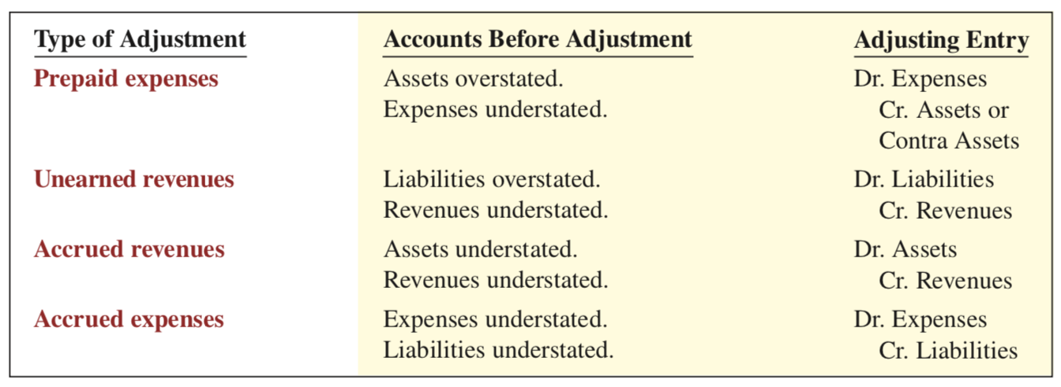

Summary of Basic Relationships
LO 3

Slide 62
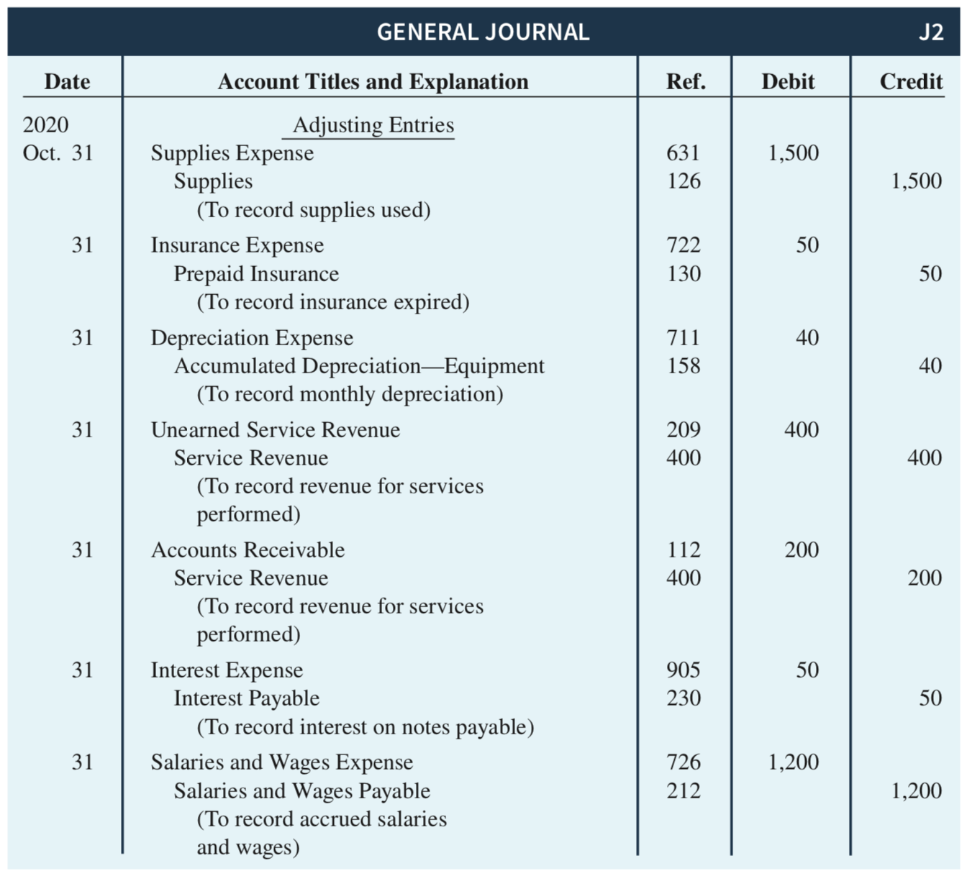
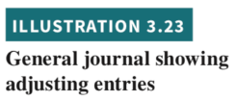
Summary of Basic Relationships
LO 3

Slide 63
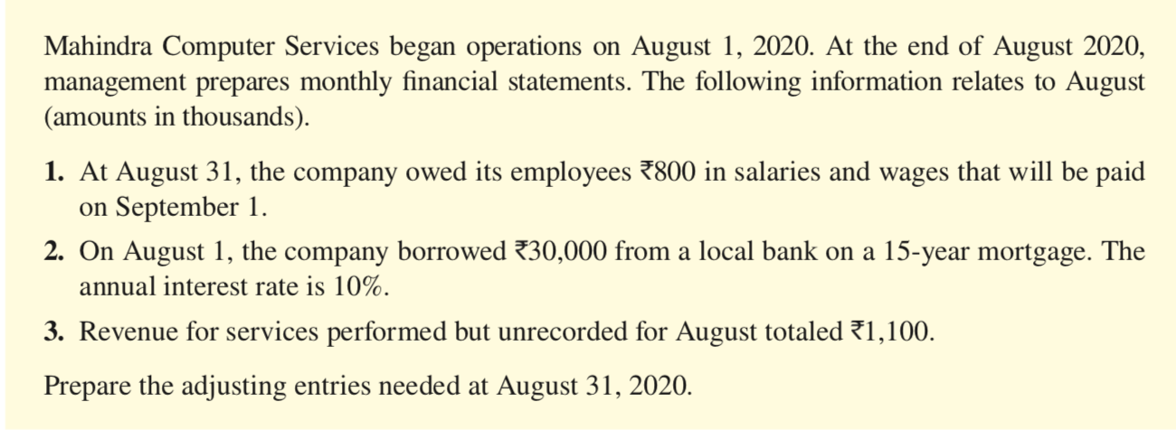
DO IT! Adjusting Entries for Accruals
ACTION PLAN
Make adjusting entries at the end of the period to recognize revenues for services performed and for expenses incurred.
Don’t forget to make adjusting entries for accruals. Adjusting entries for accruals will increase both a statement of financial position account and an income statement account.
LO 3

Slide 64
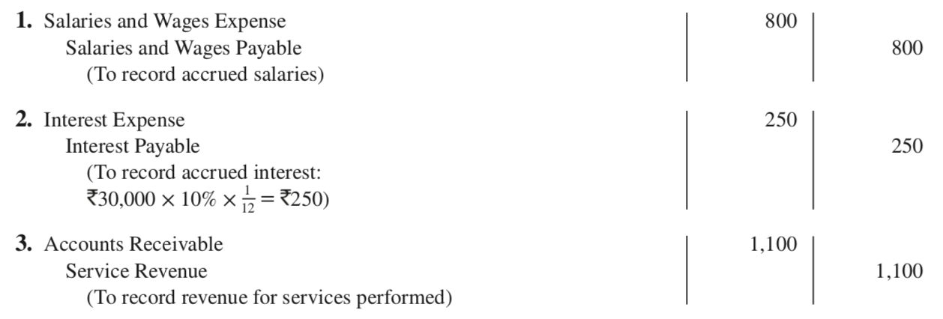
DO IT! Adjusting Entries for Accruals
Solution
LO 3

Slide 65
Learning Objective 4 Describe the nature and purpose of an adjusted trial balance.
LO 4

Slide 66
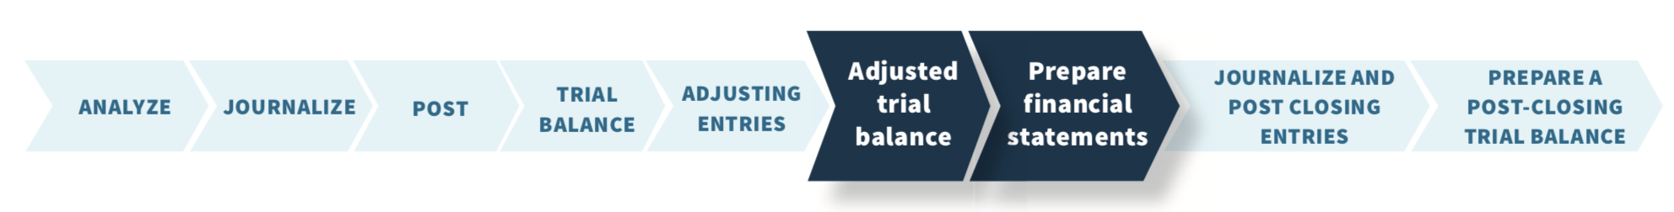
Adjusted Trial Balance and Financial Statements
Adjusted trial balance:
Proves the equality of the total debit balances and the total credit balances in the ledger after all adjustments.
Primary basis for the preparation of financial statements.
LO 4

Slide 67
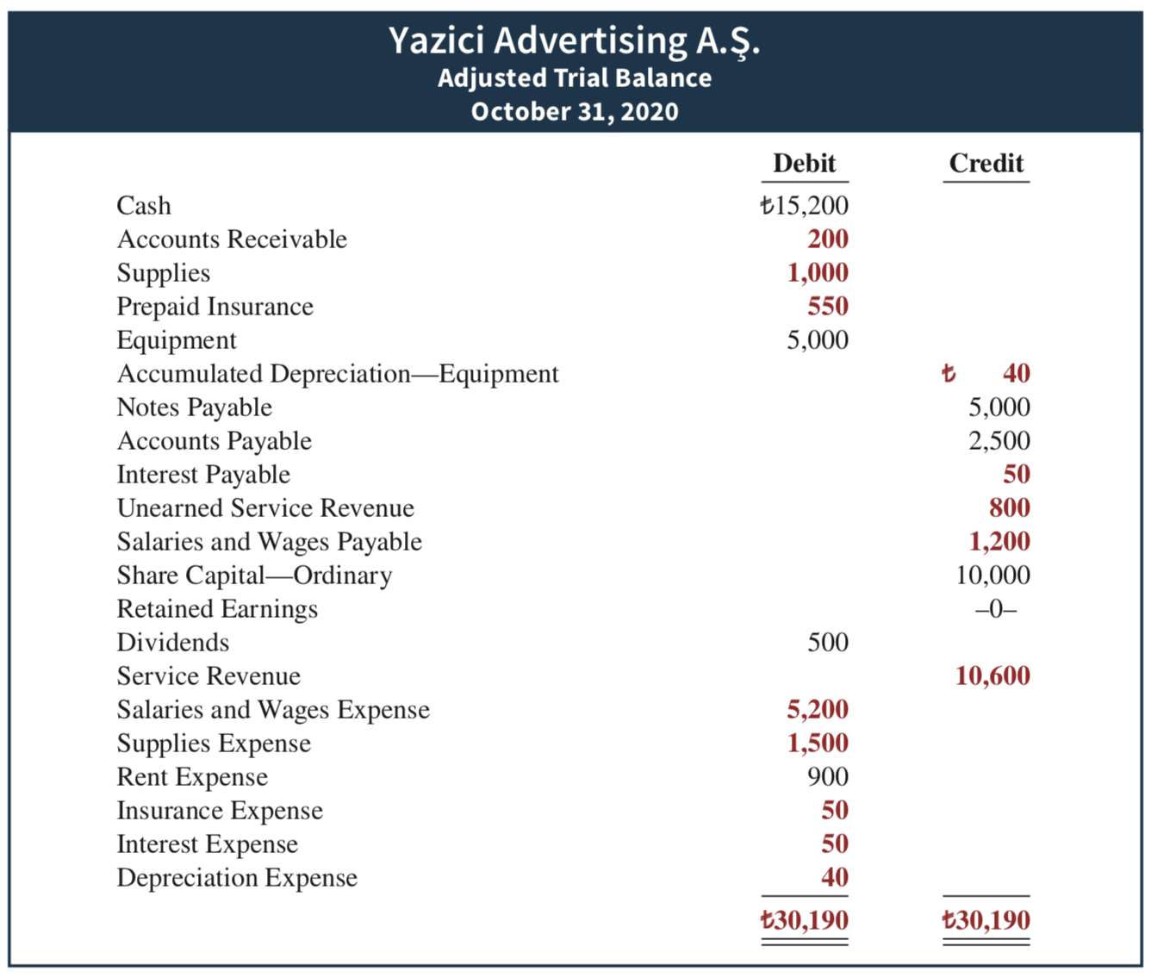

Preparing the Adjusted Trial Balance
LO 4

Slide 68
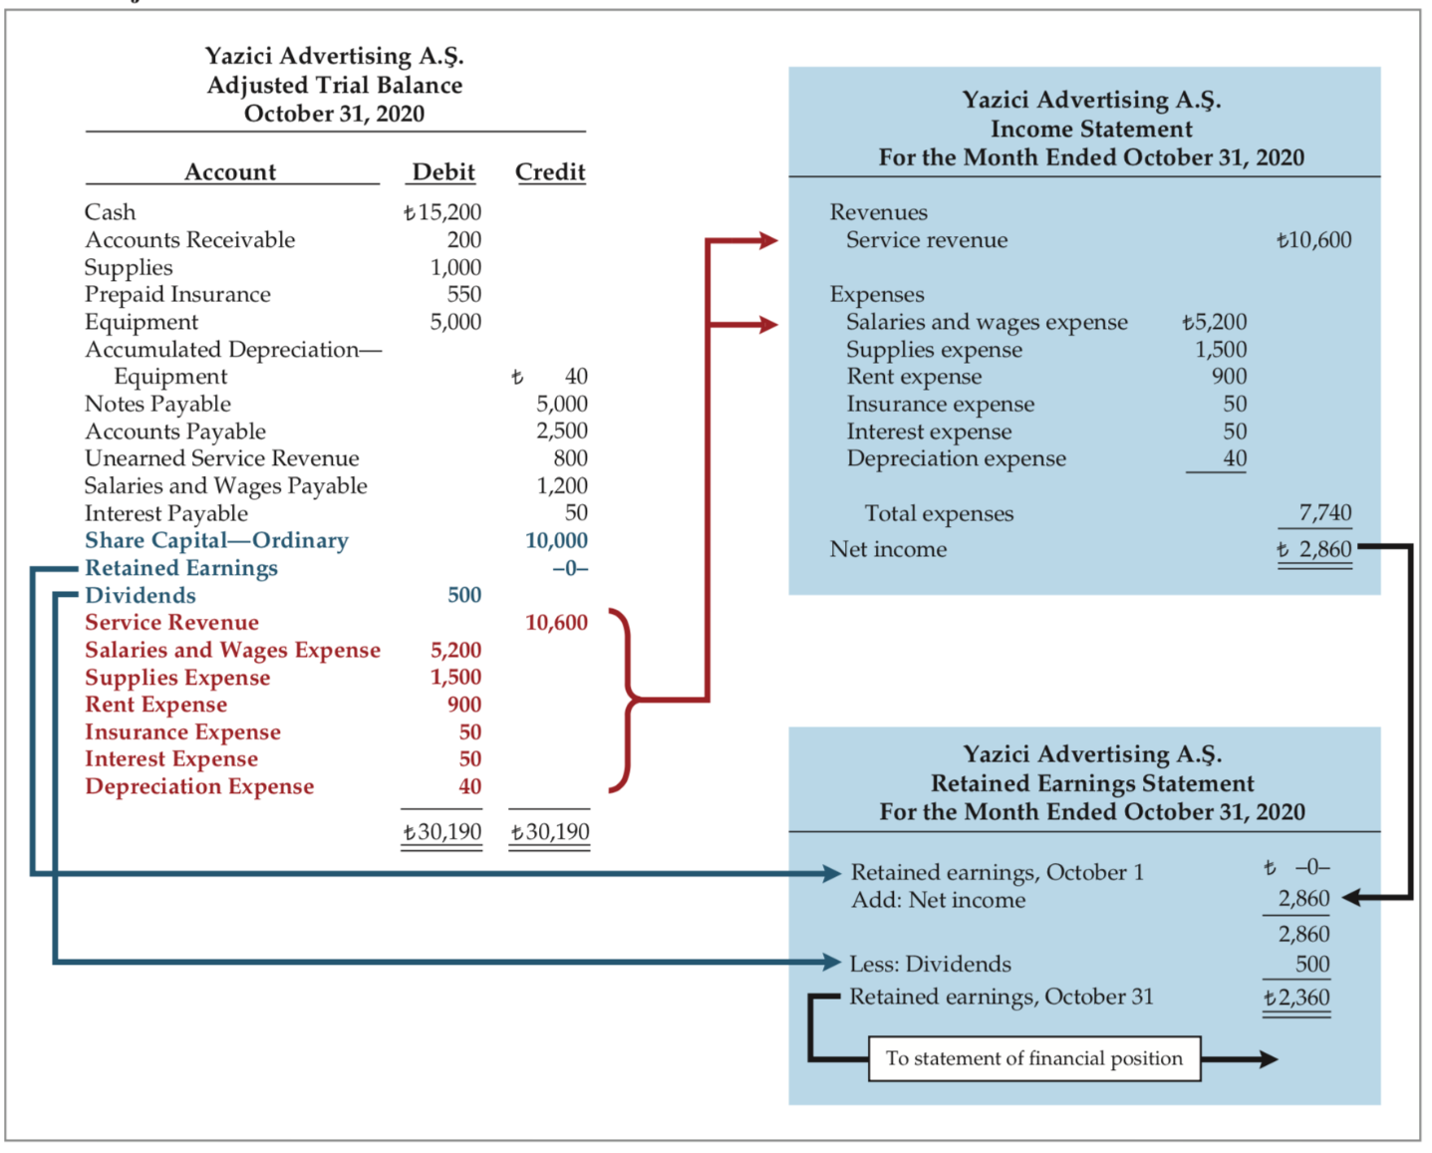
Preparing Financial Statements (1/2)
LO 4

Slide 69
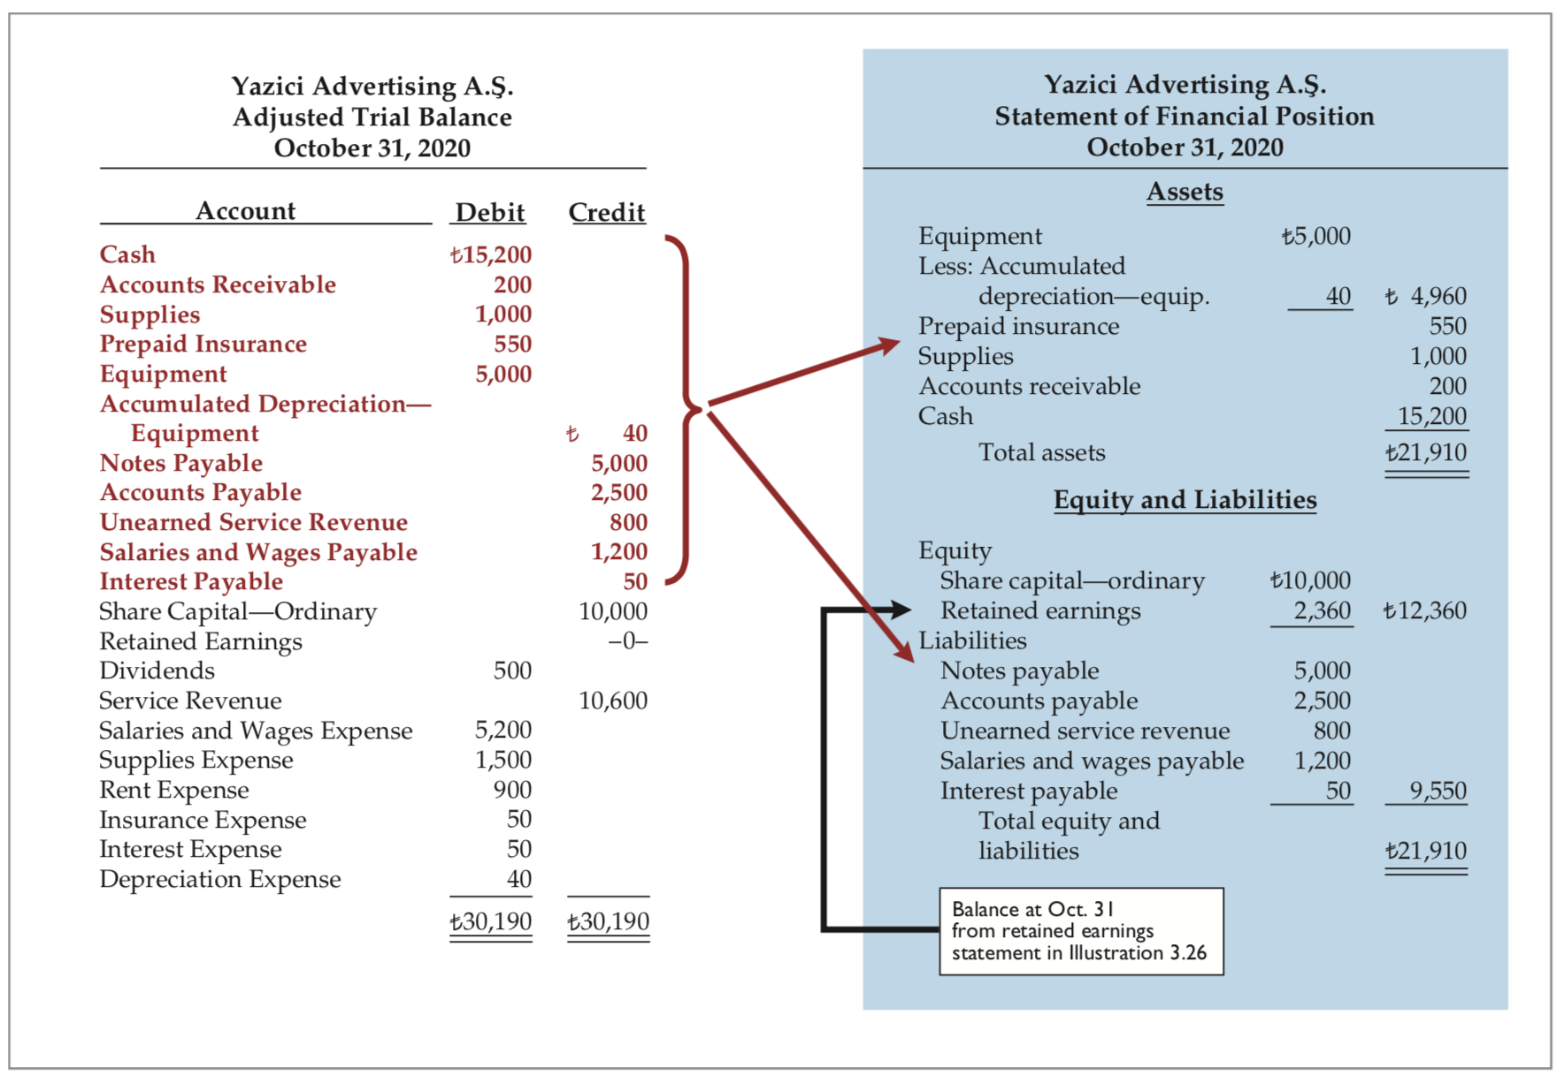
Preparing Financial Statements (2/2)
LO 4

Slide 70
Preparing Financial Statements (2/2)
LO 3

Slide 71

DO IT! Trial Balance
Continues on next slide
LO 4

Slide 72
DO IT! Trial Balance
ACTION PLAN
In an adjusted trial balance, all asset, liability, revenue, and expense accounts are properly stated.
To determine the ending balance in Retained Earnings, add net income and subtract dividends.
LO 4

Slide 73

DO IT! Adjusting Entries for Accruals
Solution (1/2)
LO 4

Slide 74

DO IT! Adjusting Entries for Accruals
Solution (2/2)
LO 4

Slide 75



Chapter Appendix Outline
Appendix 3A
Appendix 3B

Slide 76
Learning Objective 5* Prepare adjusting entries for the alternative treatment of deferrals.
LO 5*

Slide 77
Alternative Treatment of Deferrals
Alternative treatment:
When a company prepays an expense, it debits that amount to an expense account.
When it receives payment for future services, it credits the amount to a revenue account.
LO 5*

Slide 78
Prepaid Expenses Supplies
Assume: Yazici Advertising purchased supplies costing 2,500 on October 5. Yazici recorded the purchase by increasing (debiting) Supplies Expense (rather than to the asset account Supplies).
An inventory count at the close of business on October 31 reveals that 1,000 of supplies are still on hand.
Demonstrate: How do you record the adjustment for supplies?
Continues on next slide
LO 5*

Slide 79




Supplies
LO 5*

Slide 80




Prepaid Expenses Adjustment Approaches - Comparison
LO 5*

Slide 81
Unearned Revenues Service Revenue
Assume: Yazici Advertising received 1,200 on October 2 from R. Knox for advertising services expected to be completed by October 31. However, Yazici has not performed 800 of the services by October 31.
Demonstrate: How do you record the adjustment for advertising?
Continues on next slide
LO 5*

Slide 82




Service Revenue
LO 5*

Slide 83




Unearned Revenues Adjustment Approaches - Comparison
LO 5*

Slide 84

Summary of Additional Adjustment Relationships
LO 5*

Slide 85
Learning Objective 6* Discuss financial reporting concepts.
LO 6*

Slide 86


Qualities of Useful Information Fundamental Qualities
LO 6*

Slide 87
Qualities of Useful Information Enhancing Qualities
Quality: | It means:
Comparability | Different companies use the same accounting principles, and A company uses the same accounting principles and methods from year to year.
Verifiability | Independent observers, using the same methods, obtain similar results
Timeliness | It is necessary for accounting information to be relevant.
Understandability | Information is presented in a clear and concise fashion, so that reasonably informed users of that information can interpret it and comprehend its meaning.
LO 6*

Slide 88


Assumptions in Financial Reporting (1/2)
LO 6*

Slide 89

Assumptions in Financial Reporting (2/2)
LO 6*

Slide 90
Principles in Financial Reporting (1/2) Measurement Principles
IFRS generally uses one of two measurement principles, the historical cost principle or the fair value principle.
Historical cost principle (or cost principle): dictates that companies record assets at their cost. This is true not only at the time the asset is purchased, but also over the time the asset is held.
Fair value principle: states that assets and liabilities should be reported at fair value (the price received to sell an asset or settle a liability).
LO 6*

Slide 91
Principles in Financial Reporting (2/2)
Revenue Recognition Principle
Requires that companies recognize revenue in the accounting period in which the performance obligation is satisfied.
Expense Recognition Principle
Dictates that companies recognize expense in the period in which they make efforts to generate revenue. Thus, expenses follow revenues.
Full Disclosure Principle
Requires that companies disclose all circumstances and events that would make a difference to financial statement users.
If an important item cannot reasonably be reported directly in one of the four types of financial statements, then it should be discussed in notes that accompany the statements.
LO 6*

Slide 92

Cost Constraint
It weighs the cost that companies will incur to provide the information against the benefit that financial statement users will gain from having the information available.
LO 6*

Slide 93
Copyright
Copyright © 2019 John Wiley & Sons, Inc.
All rights reserved. Reproduction or translation of this work beyond that permitted in Section 117 of the 1976 United States Act without the express written permission of the copyright owner is unlawful. Request for further information should be addressed to the Permissions Department, John Wiley & Sons, Inc. The purchaser may make back-up copies for his/her own use only and not for distribution or resale. The Publisher assumes no responsibility for errors, omissions, or damages, caused by the use of these programs or from the use of the information contained herein.

